Slide 1
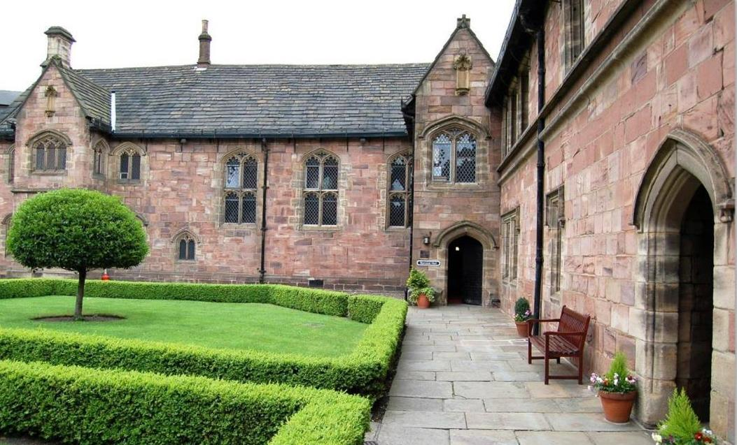
Manchester Chetham’s School
www.uklanguagecourses.com

Slide 2
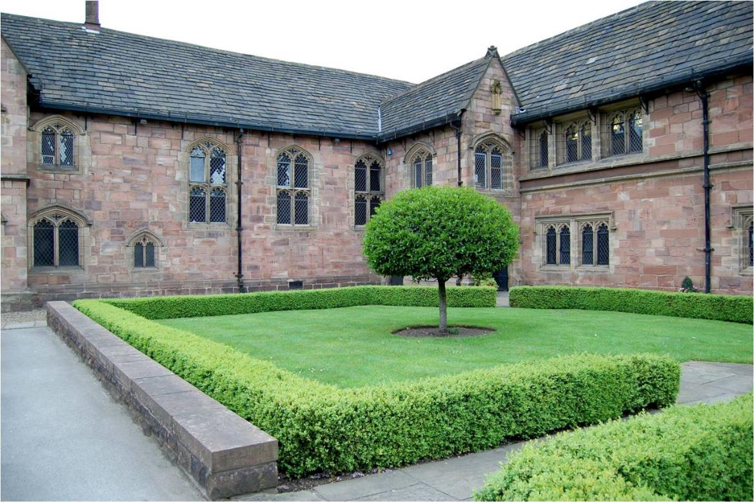
Manchester Chetham’s School - External

Slide 3
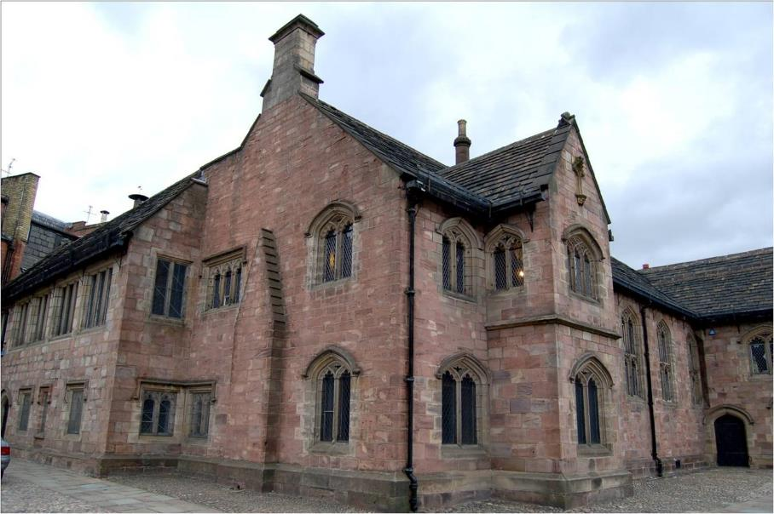
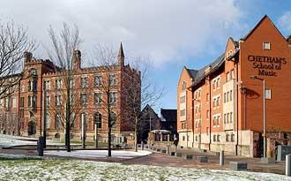
Manchester Chetham’s School - External

Slide 4
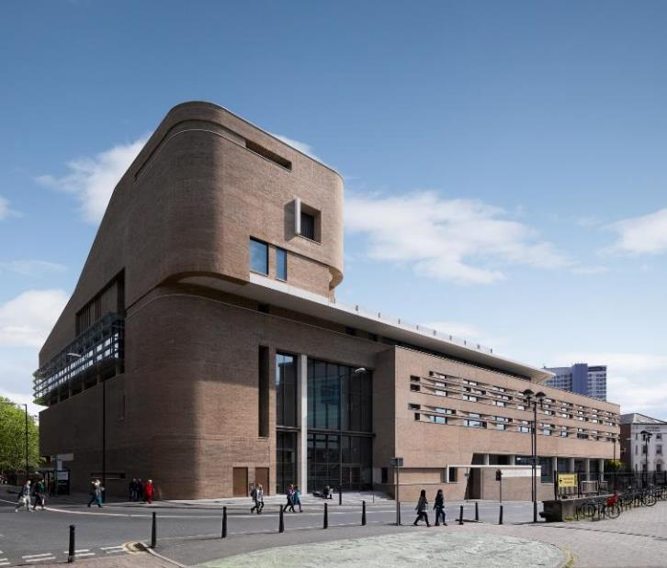
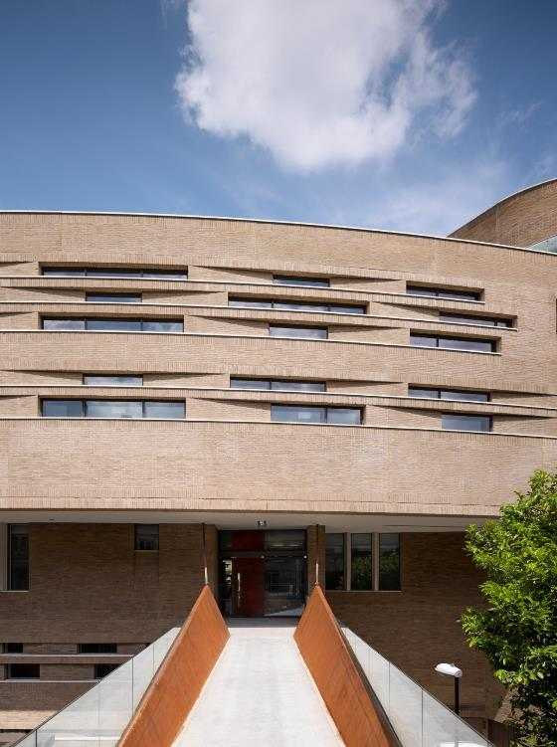
Manchester Chetham’s School – New Buildings

Slide 5
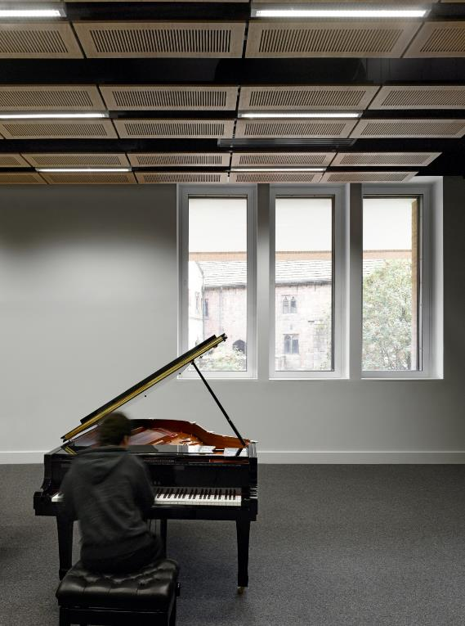
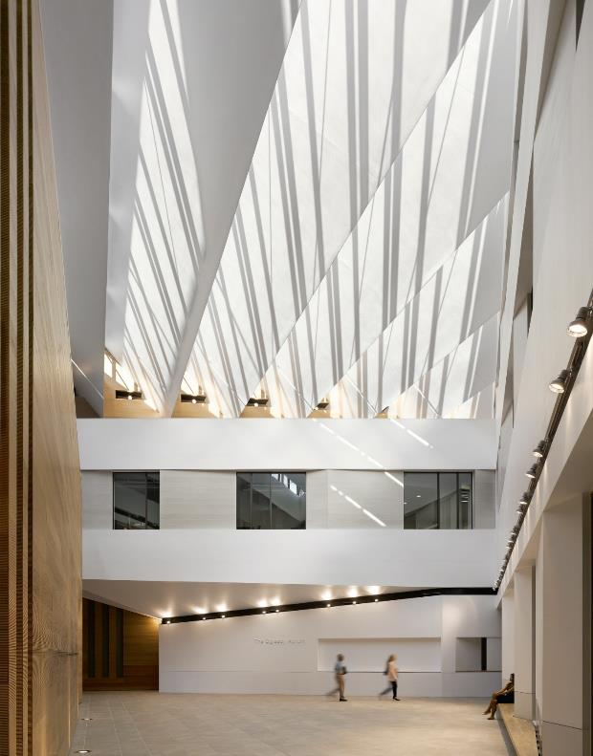
Manchester Chetham’s School – New Buildings

Slide 6
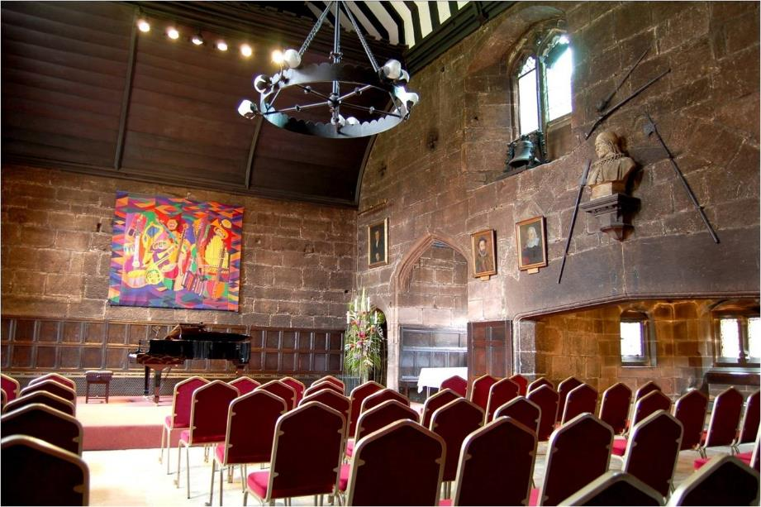
Manchester Chetham’s School - Mediaeval Presentation Hall

Slide 7
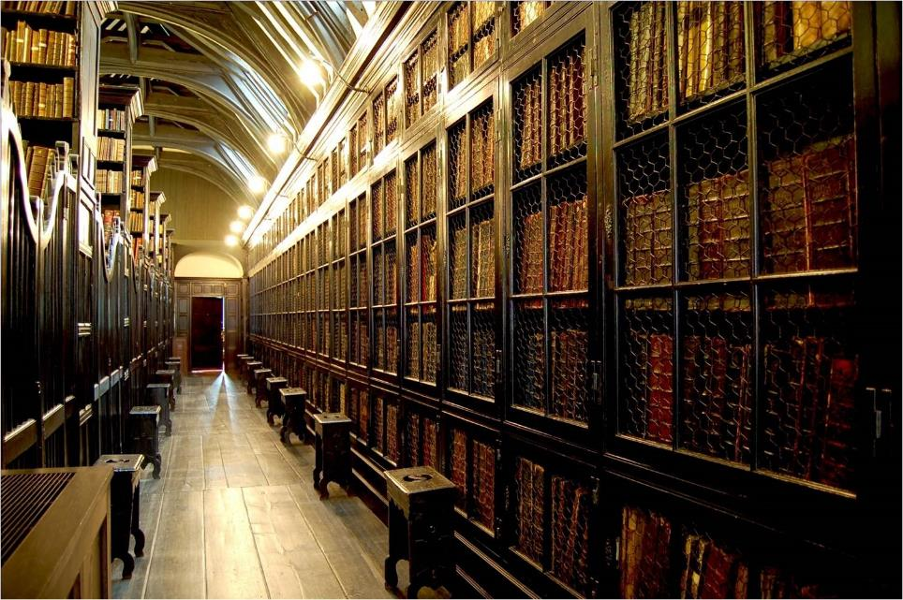
Manchester Chetham’s School Library

Slide 8
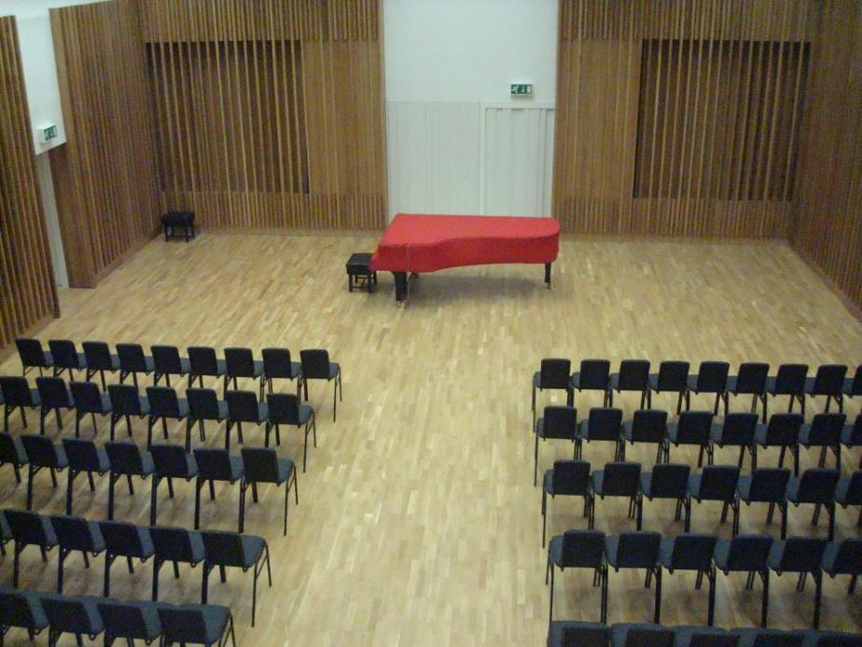
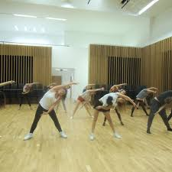
Manchester Chetham’s School – New Buildings
Used for Dance Lessons (as seen here) and Evening Activities

Slide 9
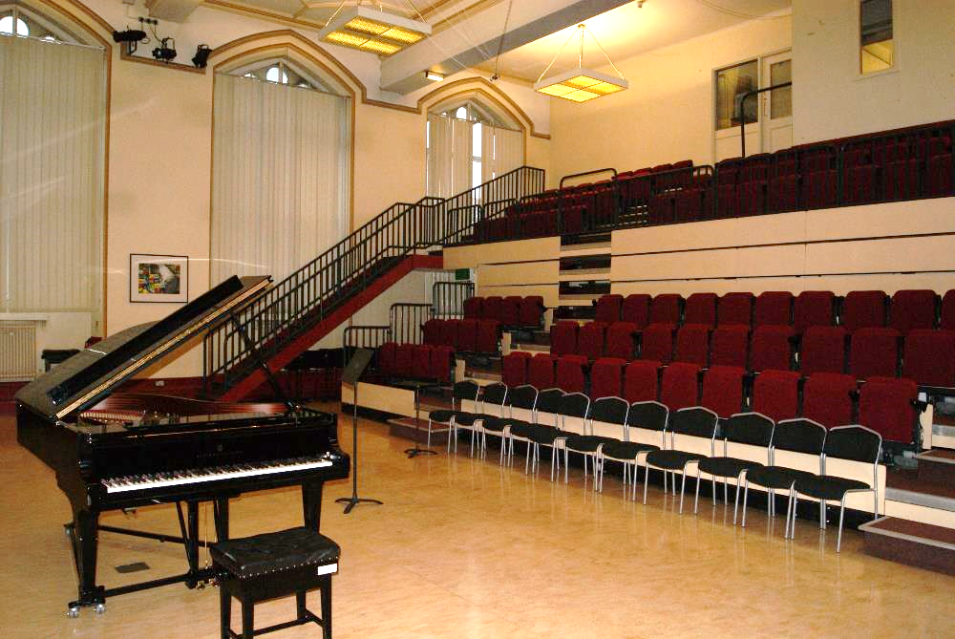
Manchester Chetham’s School - Main Hall
Used for Drama Lessons and Evening Activities

Slide 10
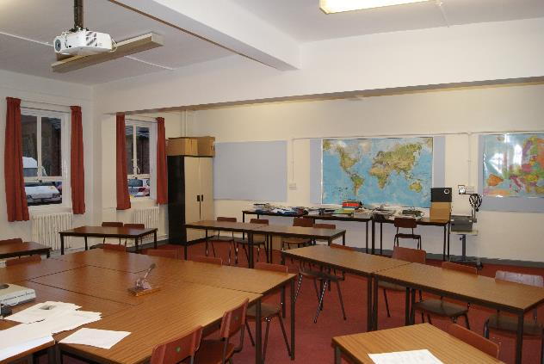
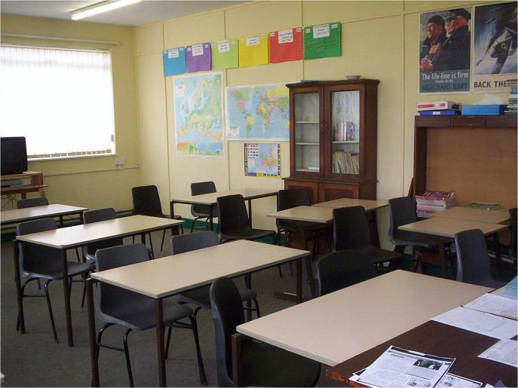
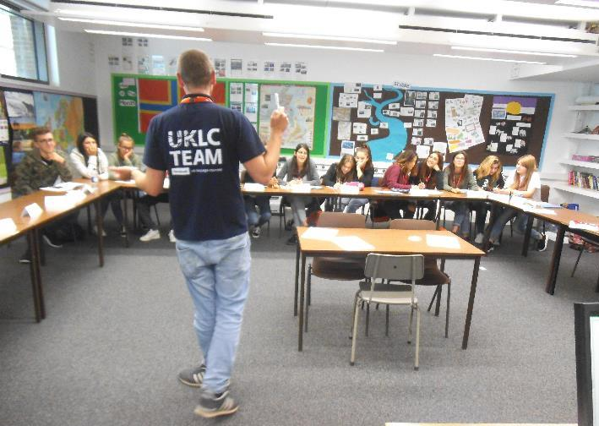
Manchester Chetham’s School - Classroom

Slide 11
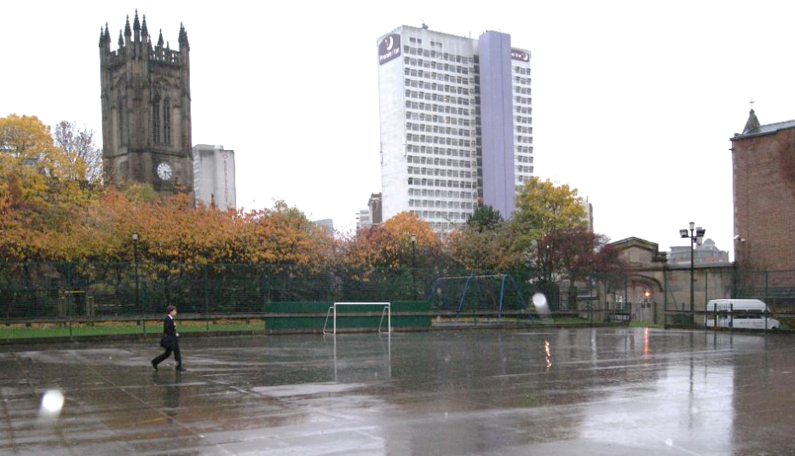
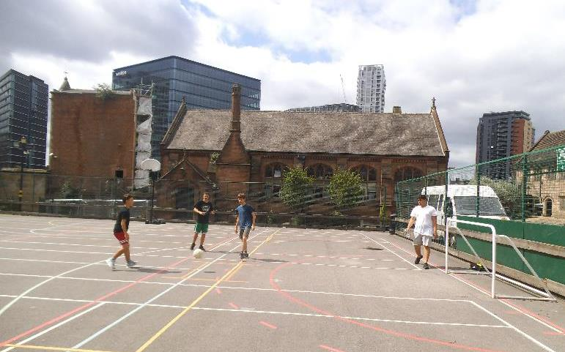
Manchester Chetham’s School –
Outdoor Games Area

Slide 12
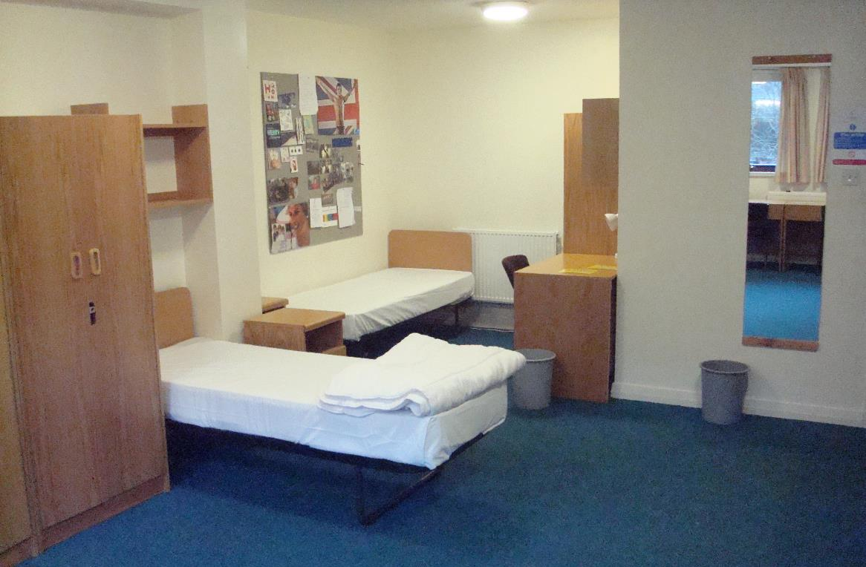
Manchester Chetham’s School – Accommodation
(Single, Twin, Single en-suite, Twin en-suite & Multi-bedded en-suite rooms)

Slide 13
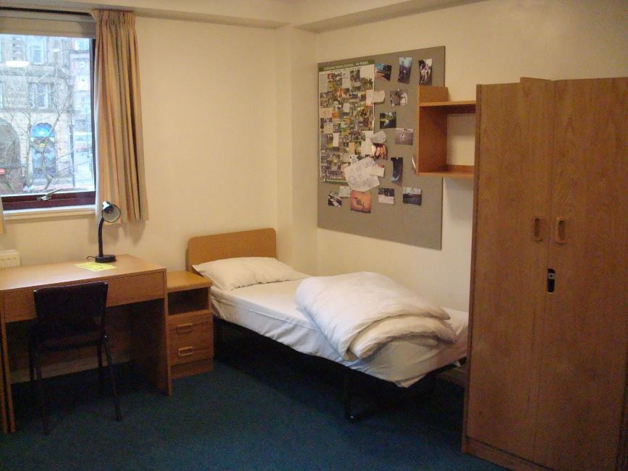
Manchester Chetham’s School - Accommodation

Slide 14
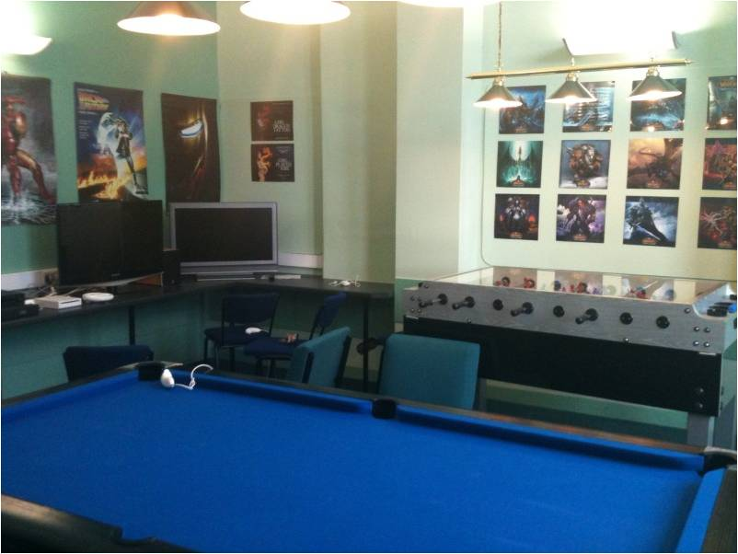
Manchester Chetham’s School - Accommodation Recreation Area

Slide 15
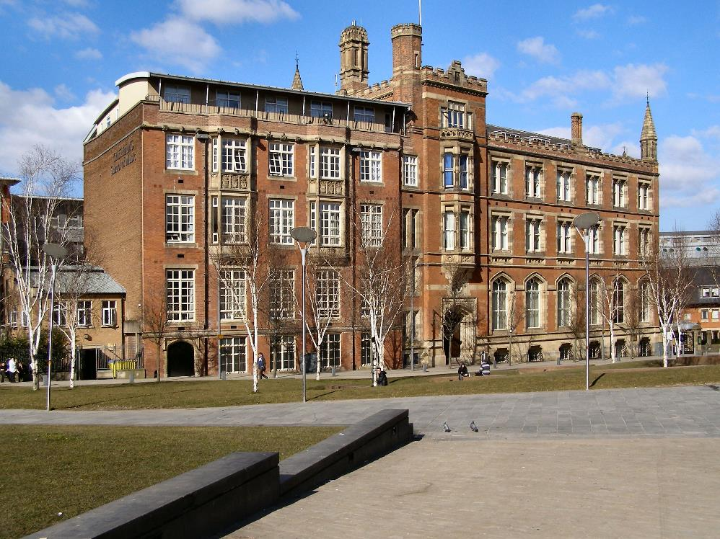
Manchester Chetham’s School – External

Slide 16
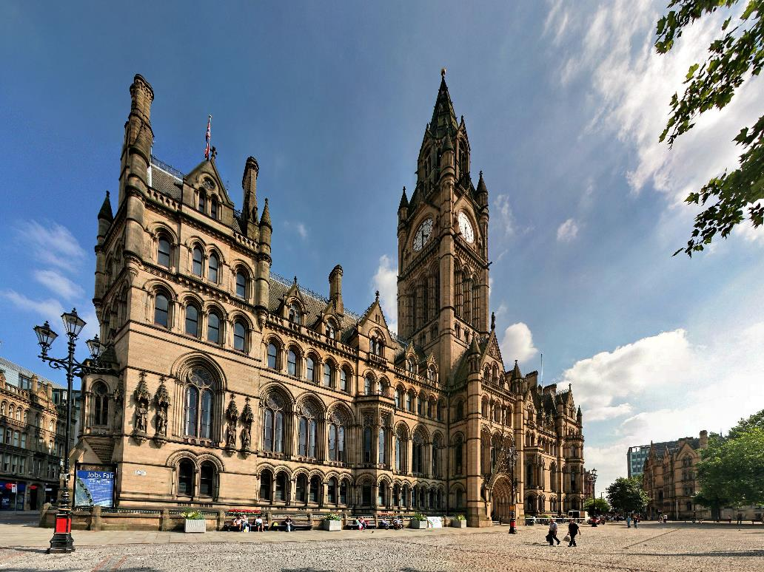
Manchester

Slide 17
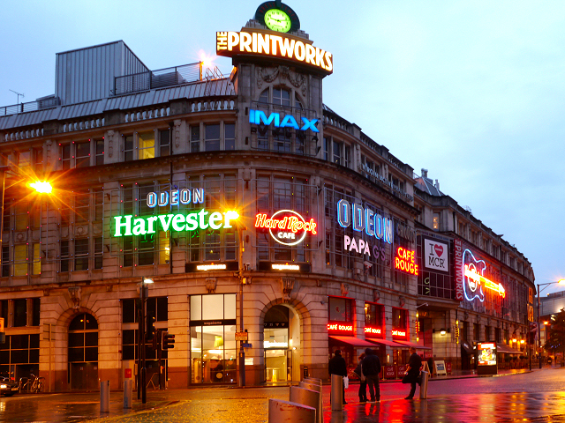
Manchester

Slide 18
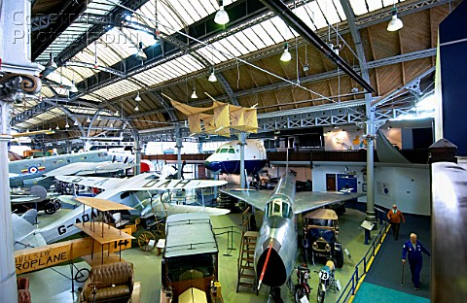
Excursion – Manchester with Museum of Science and Industry

Slide 19
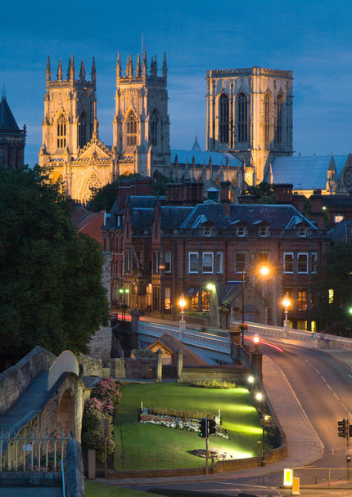
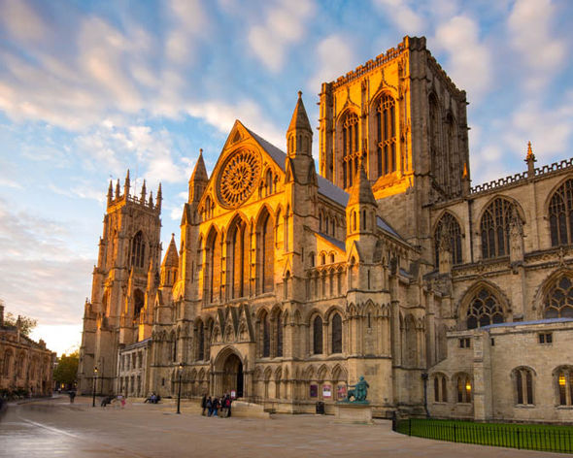
Excursion –York with York Minster

Slide 20
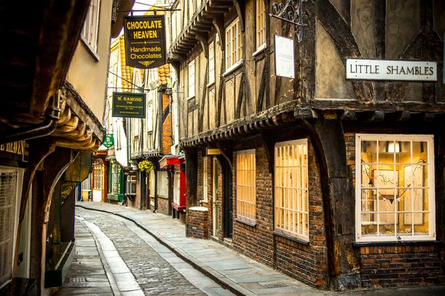
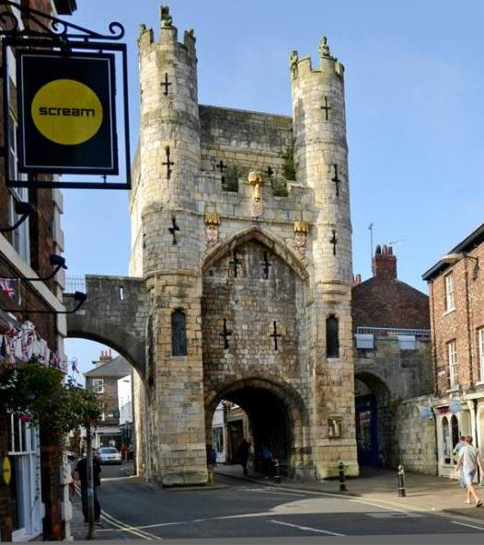
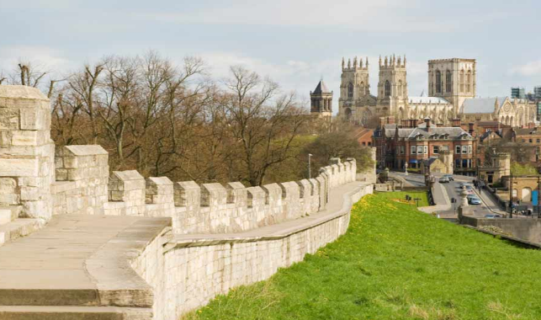
Excursion – York with York Minster

Slide 21
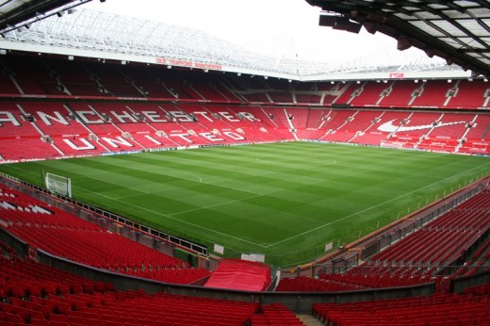
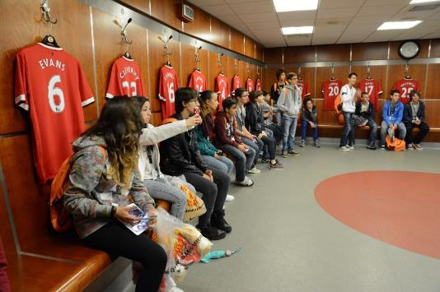
Excursion – Manchester Utd & Old Trafford

Slide 22
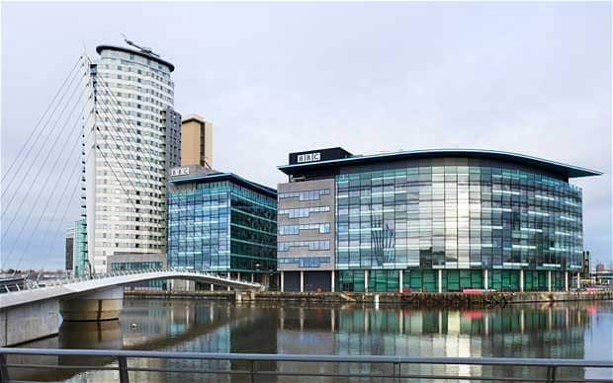
Excursion – Salford with BBC Head Quarters

Slide 23
Excursion – Salford with Imperial War Musuem

Slide 24
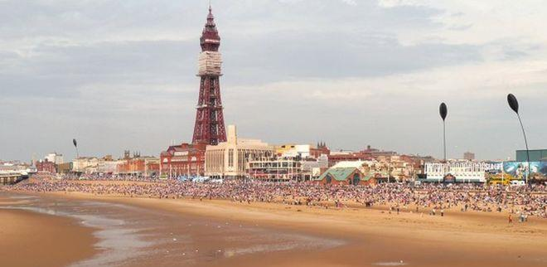
Excursion – Blackpool with Pleasure Beach

Slide 25
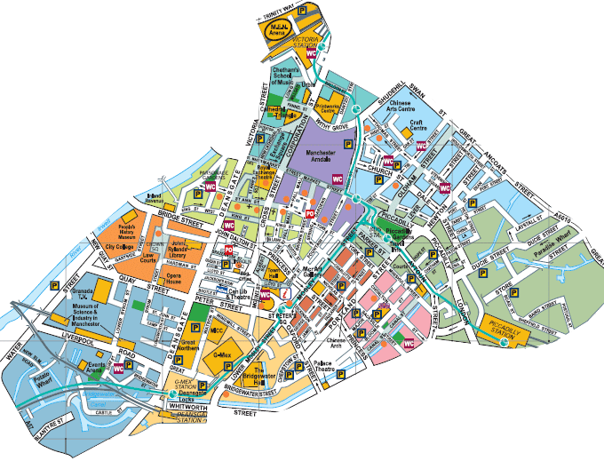
Manchester City Centre

