Slide 1
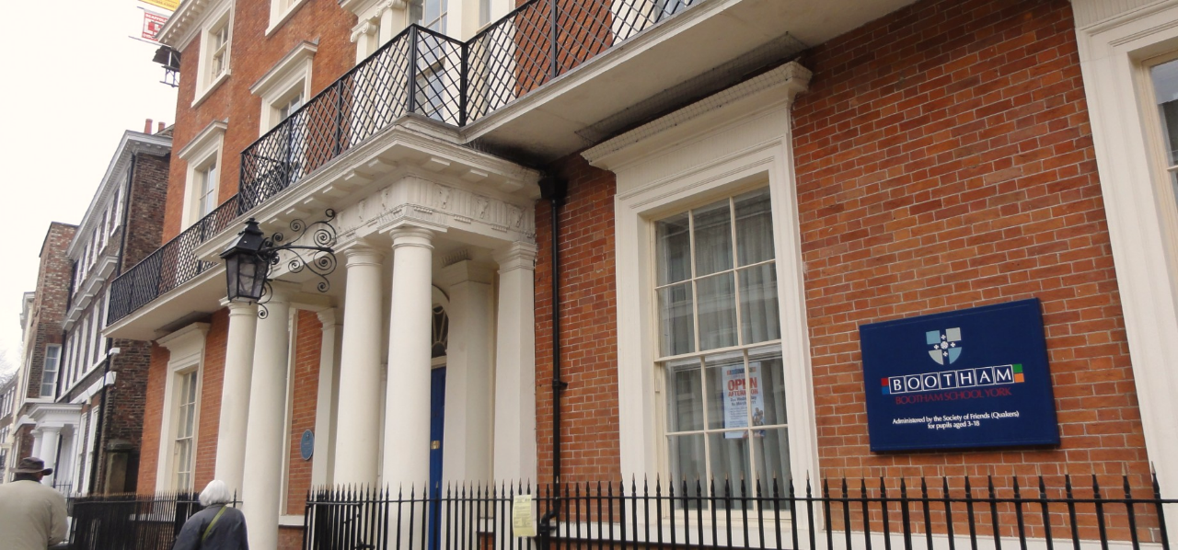
York, Bootham School
www.uklanguagecourses.com

Slide 2
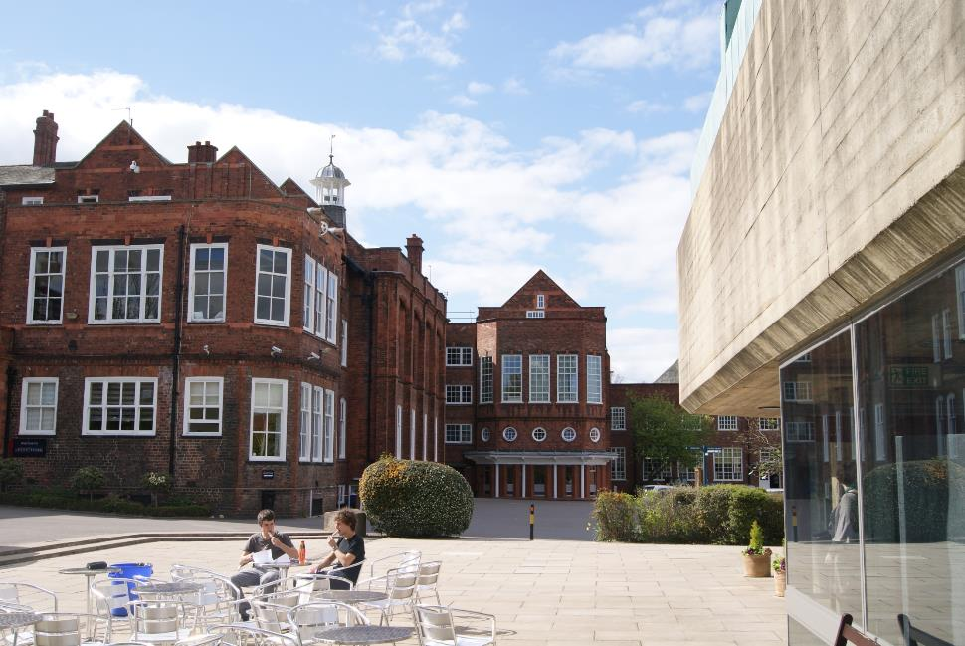
Bootham School – Main Building

Slide 3
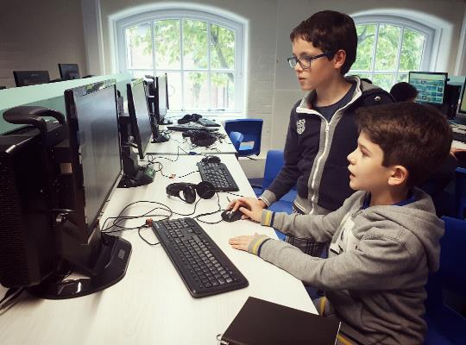
Bootham School – Computer Suite

Slide 4
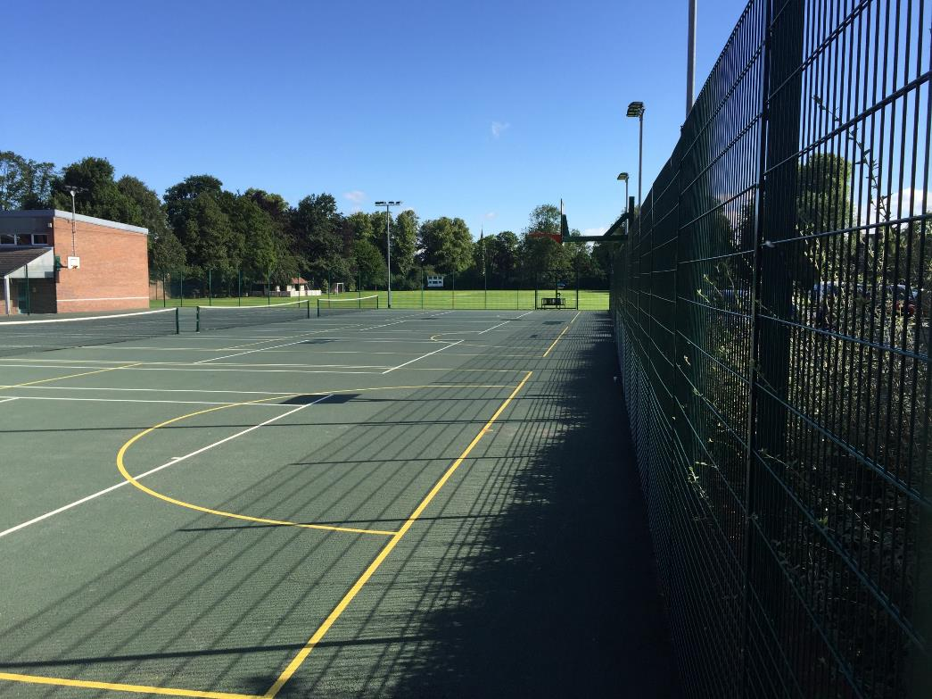
Bootham School - Outdoor Tennis Courts

Slide 5
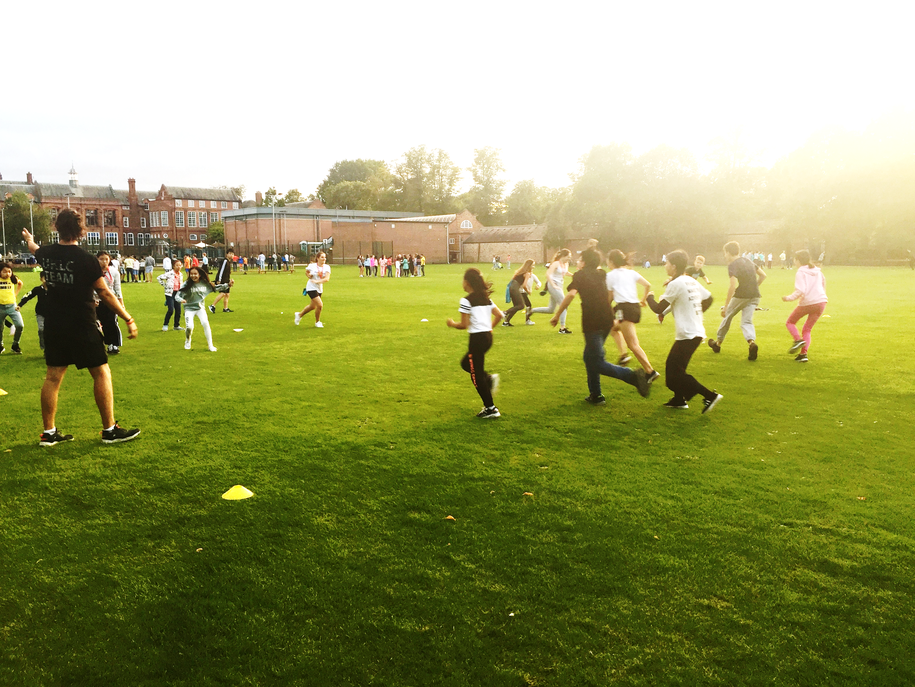
Bootham School – Sports Field

Slide 6
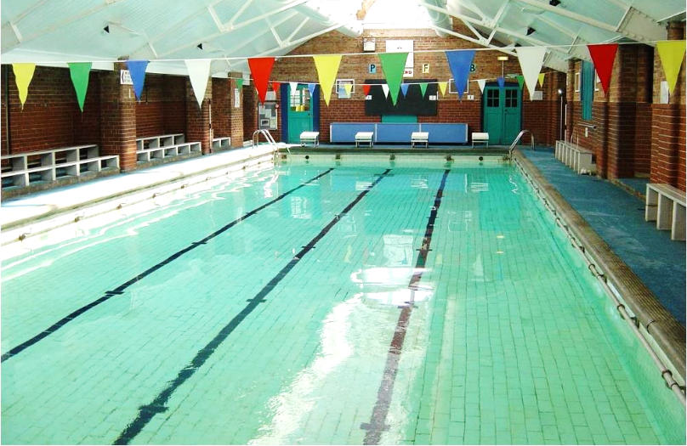
Bootham School – Indoor Swimming Pool

Slide 7
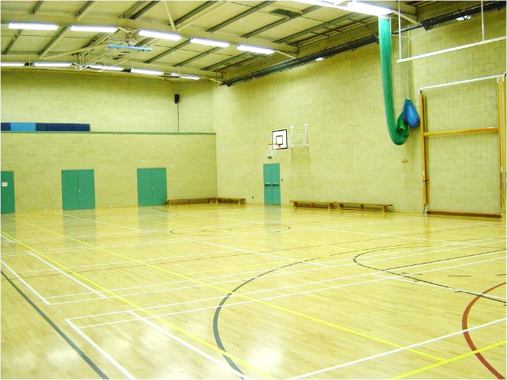
Bootham School - Indoor Sports Hall

Slide 8
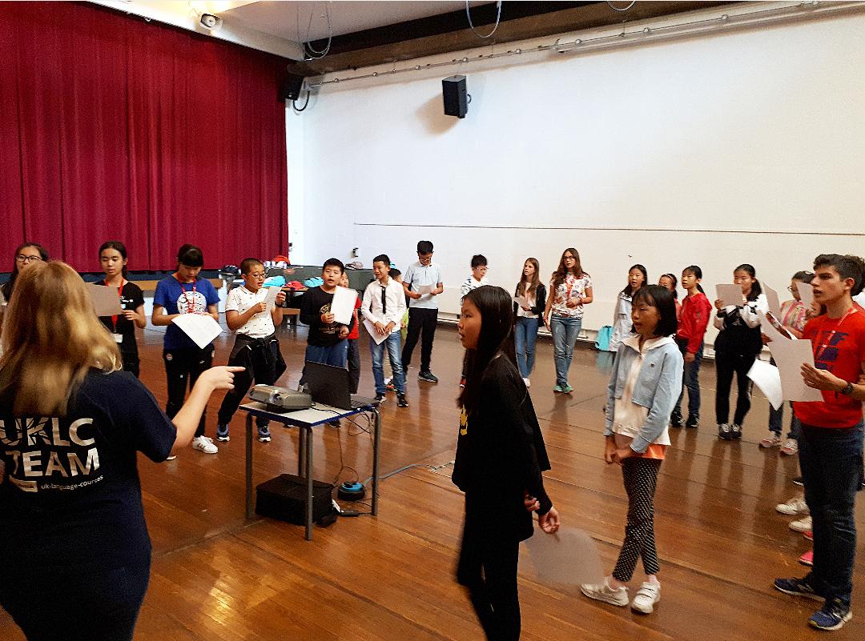
Bootham School – Main Hall
Used for Drama lessons (as seen here), Dance lessons and Evening Activities

Slide 9
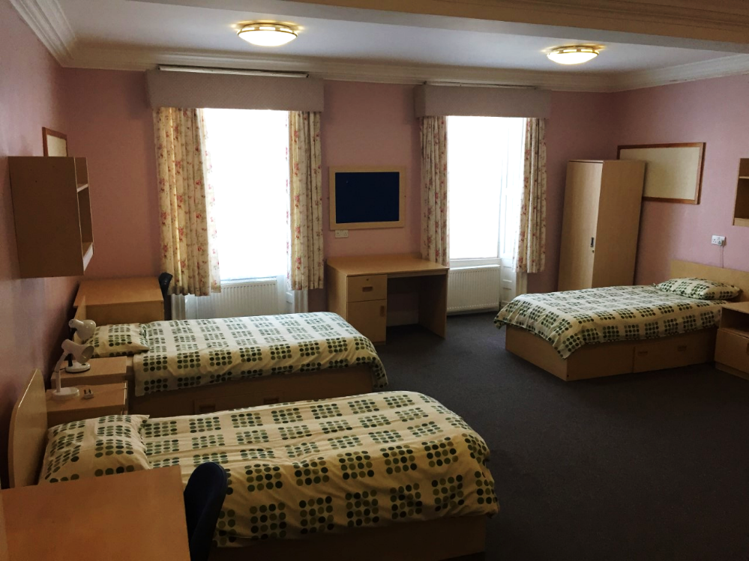
Accommodation
Rowntree House

Slide 10
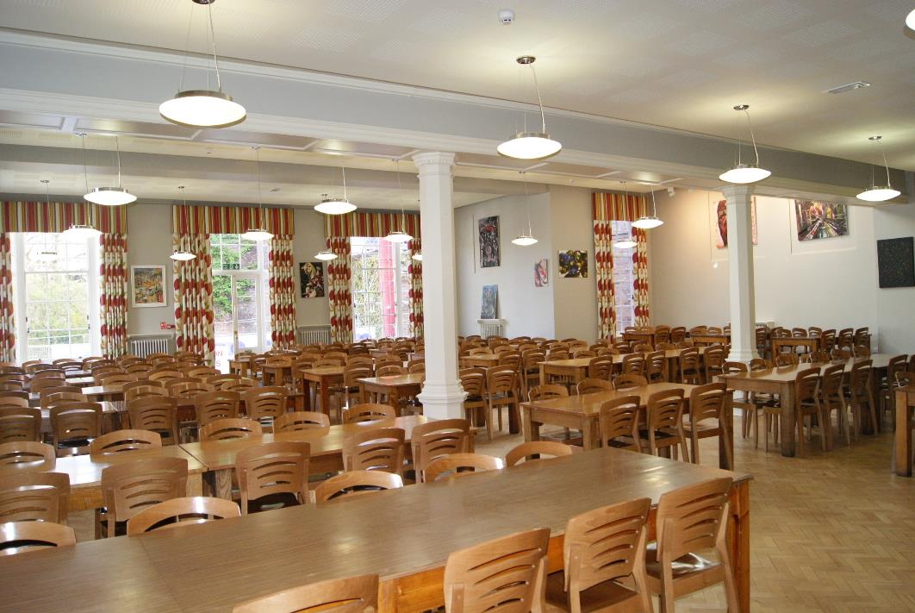
Bootham School - Dining Hall

Slide 11
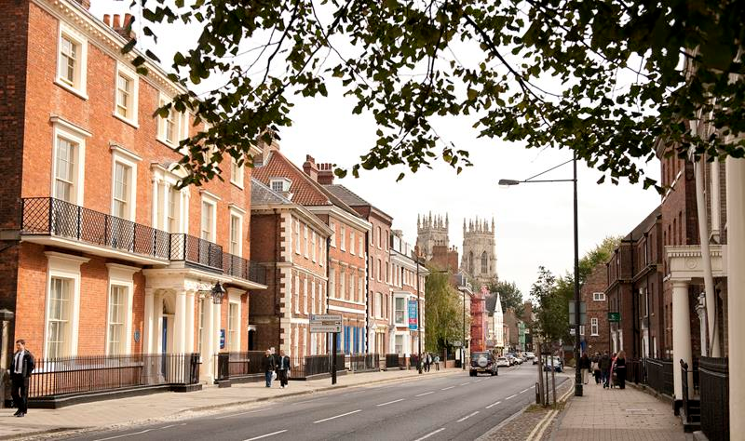
Only a five minute walk to the City Centre!
Bootham School
The York Minster

Slide 12
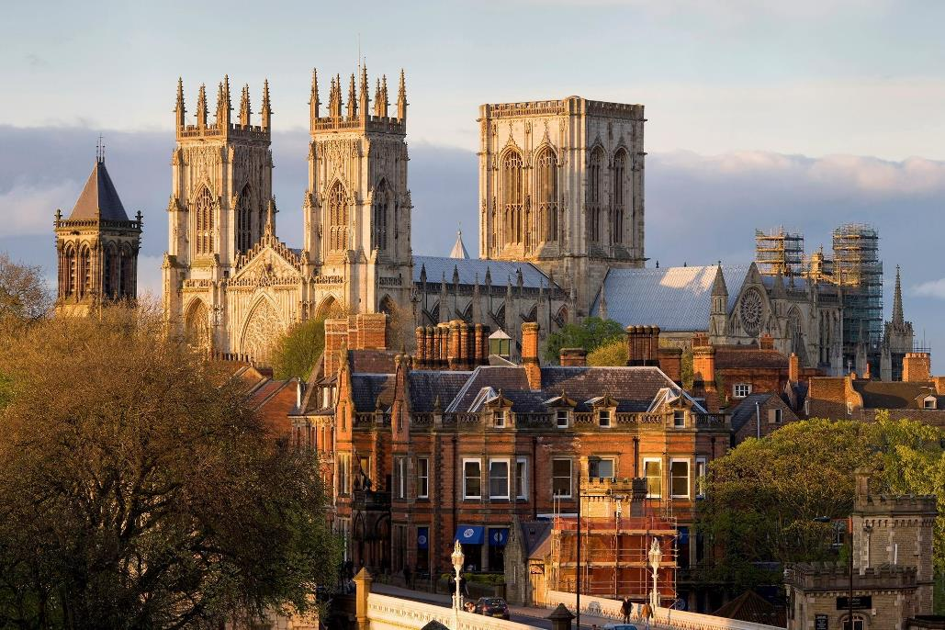
York

Slide 13
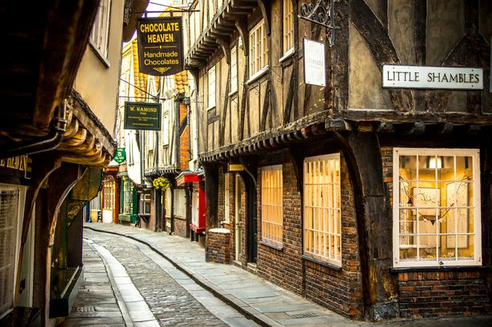
York

Slide 14
Excursion – Whitby & Bark Endeavour

Slide 15
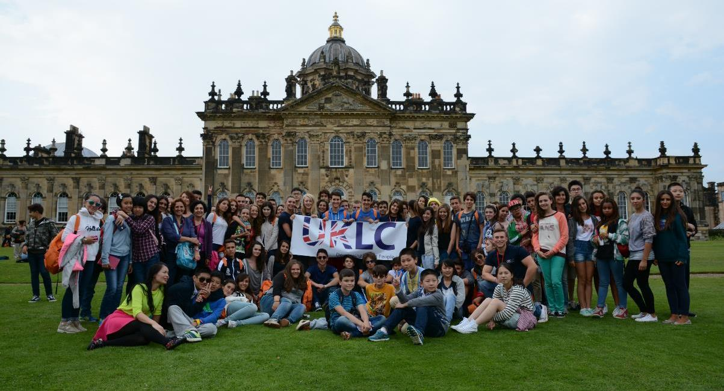
Excursion – Castle Howard

Slide 16
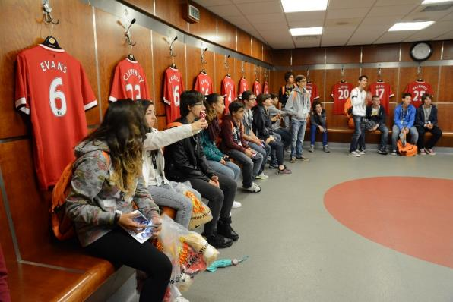
Excursion – Manchester Utd & Old Trafford

