Slide 1
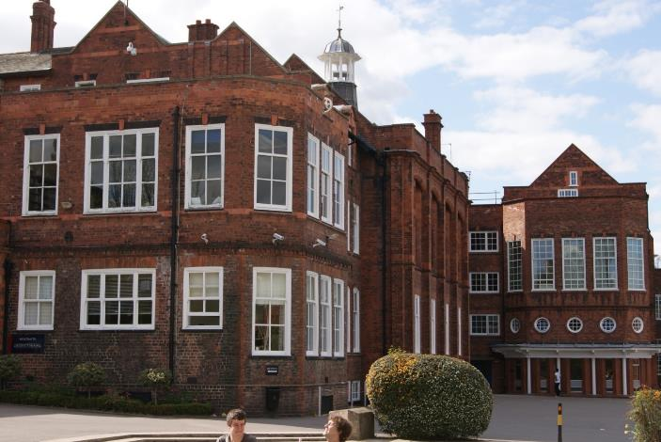
York, Bootham School
www.uklanguagecourses.com

Slide 2
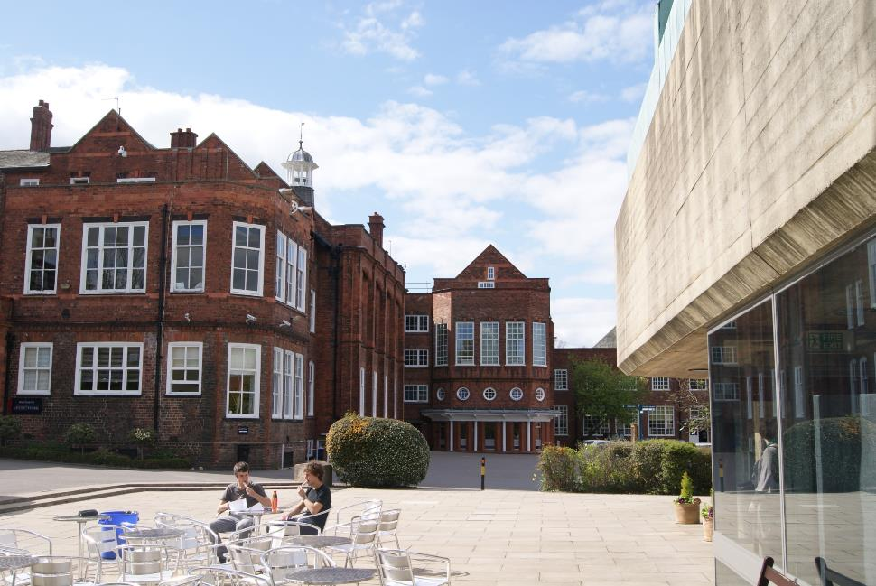
Bootham School – Main Building External

Slide 3
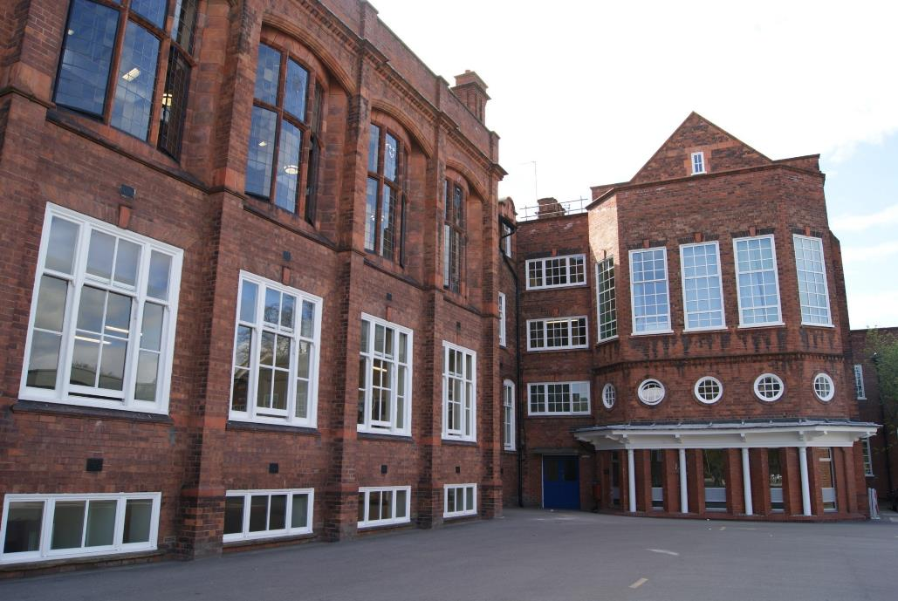
Bootham School – Main Building

Slide 4
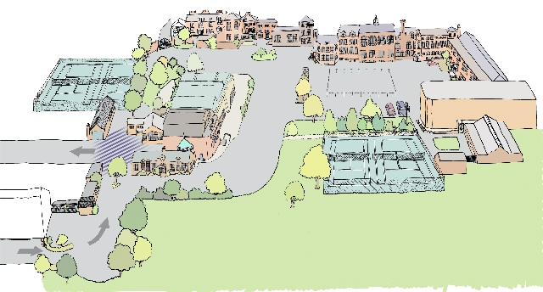
Bootham School Layout

Slide 5
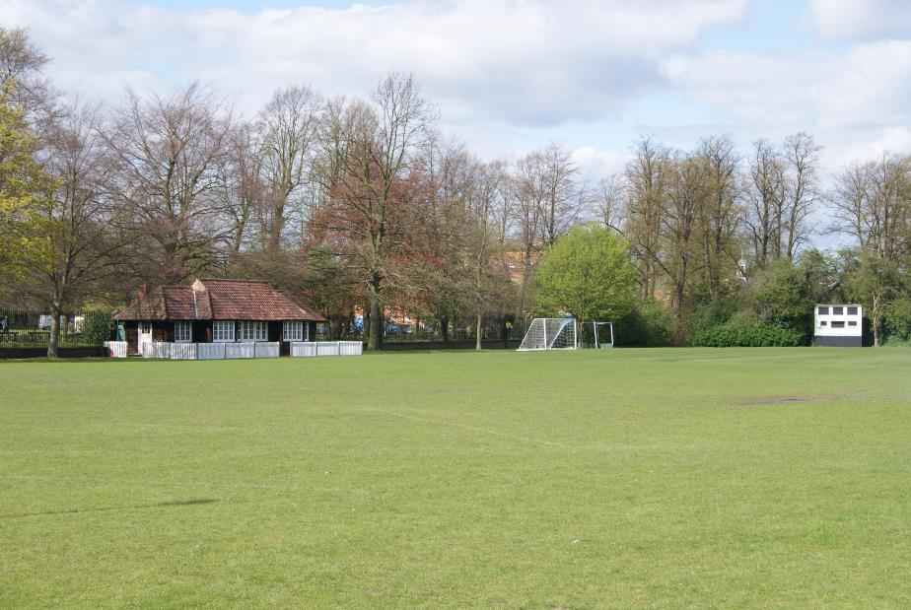
Bootham School – Sports Grounds

Slide 6
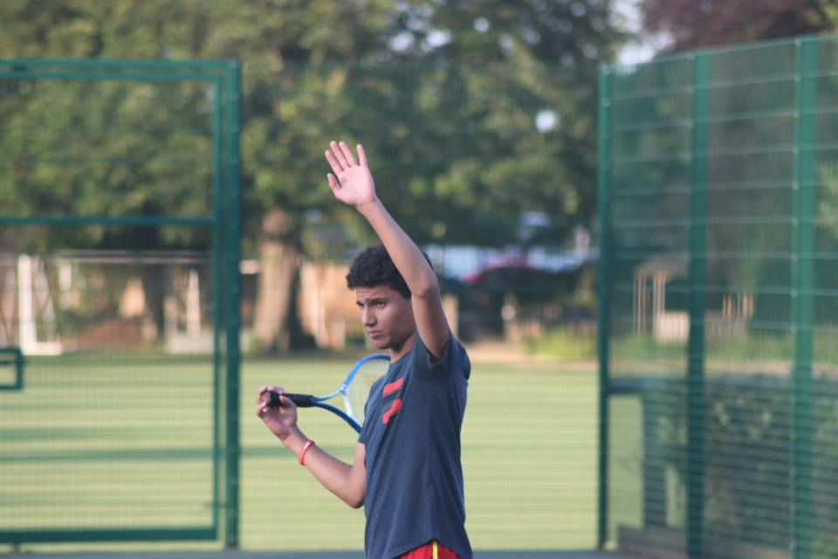
Bootham School Outdoor Tennis Courts

Slide 7
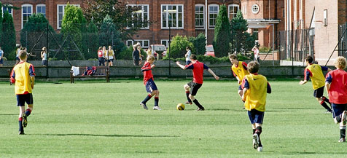
Bootham School Football Pitch

Slide 8
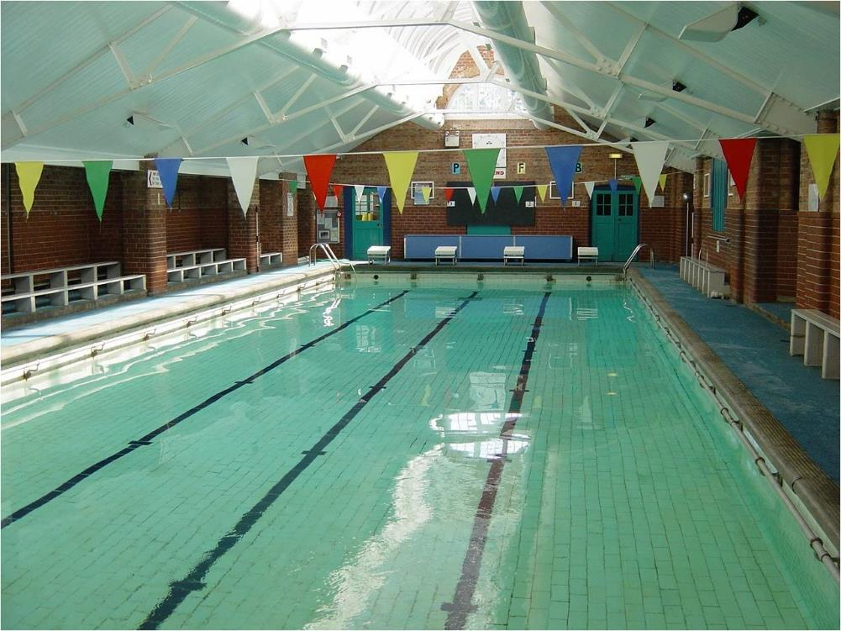
Bootham School – Indoor Swimming Pool

Slide 9
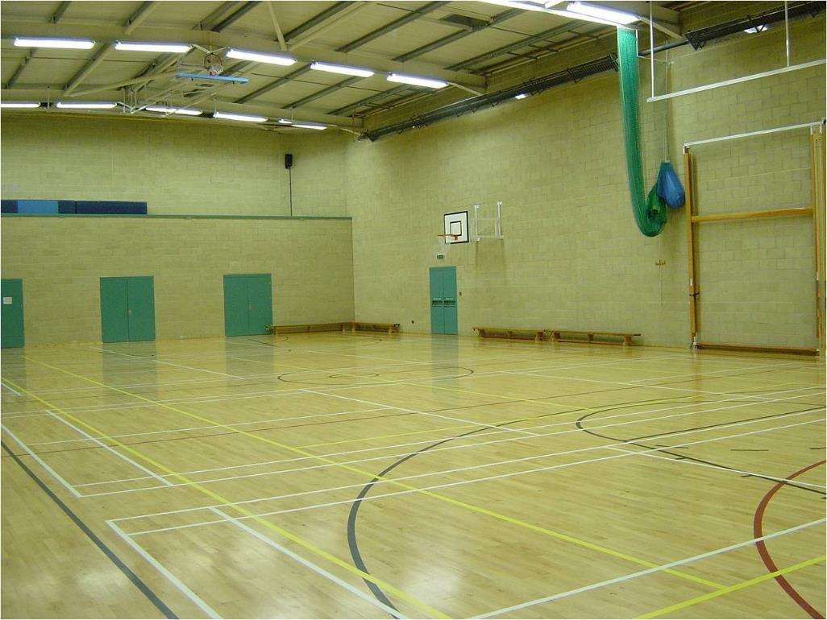
Bootham School - Indoor Sports Hall

Slide 10
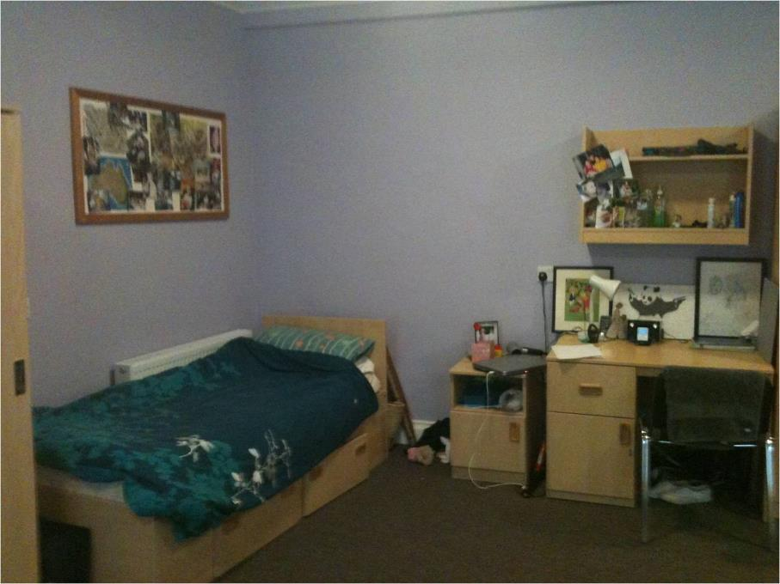
Accommodation

Slide 11
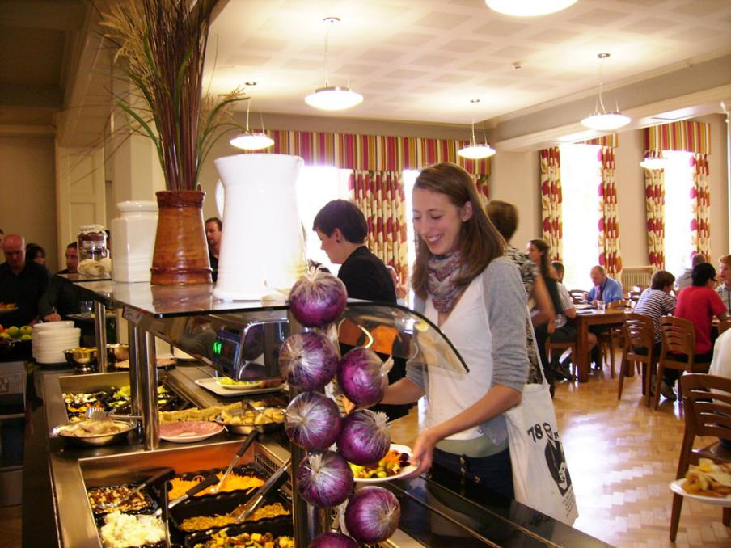
Bootham School - Servery

Slide 12
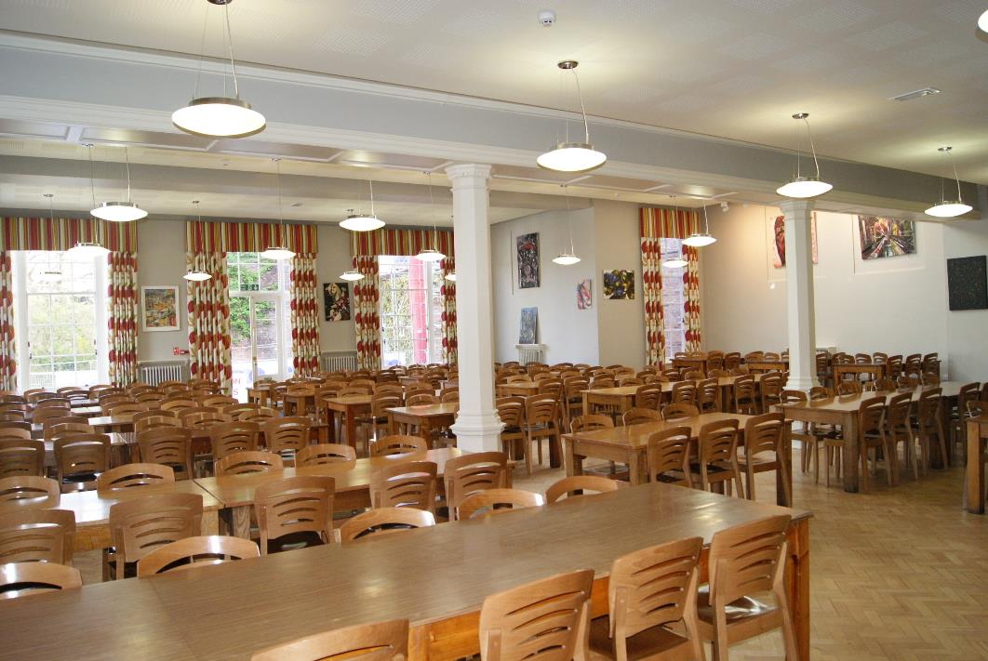
Bootham School - Dining Hall

Slide 13
York

Slide 14
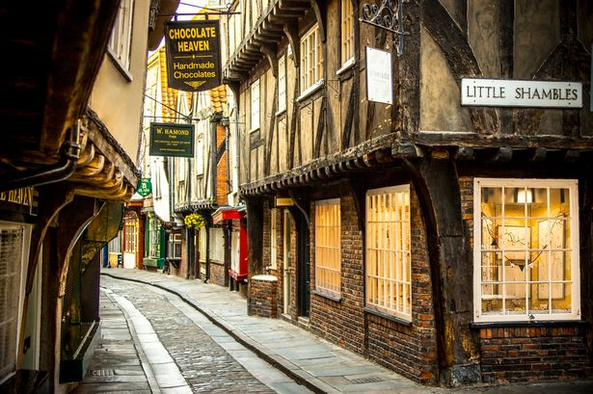
York

Slide 15
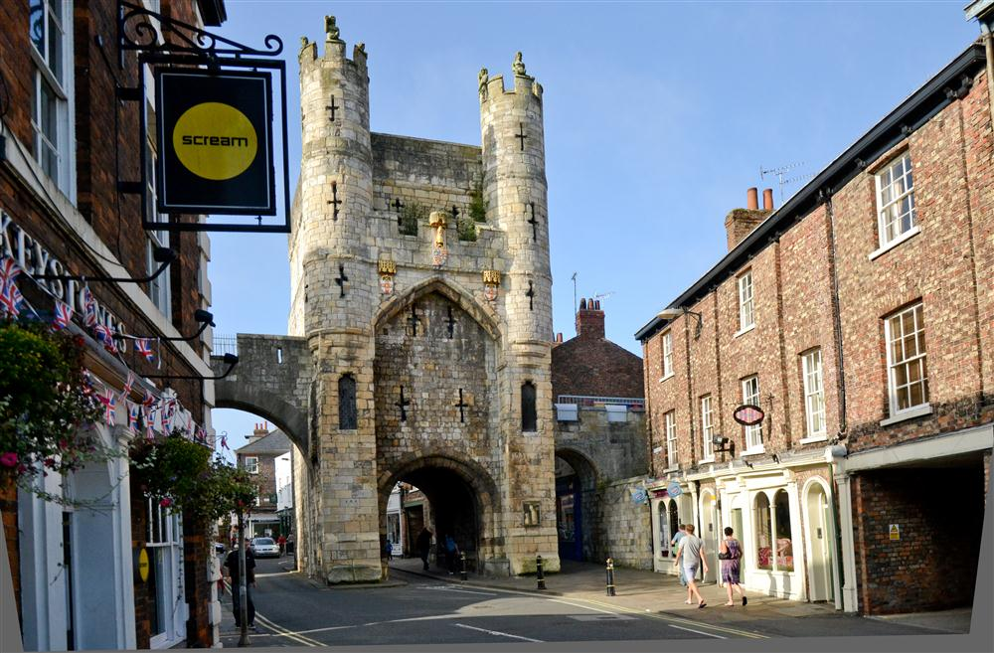
York

Slide 16
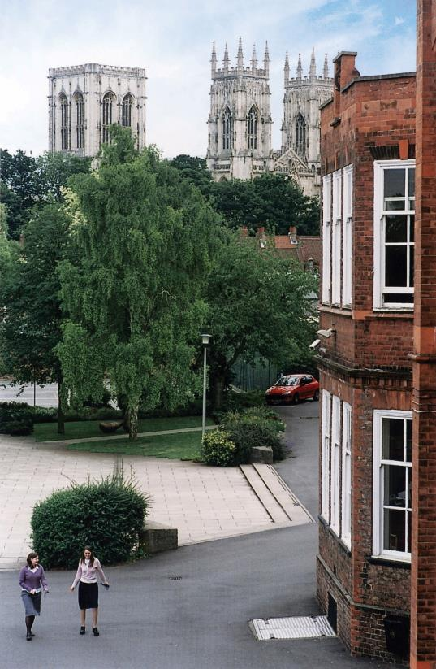
York Minster &
Bootham School

Slide 17
Excursion – Whitby & Bark Endeavour

Slide 18
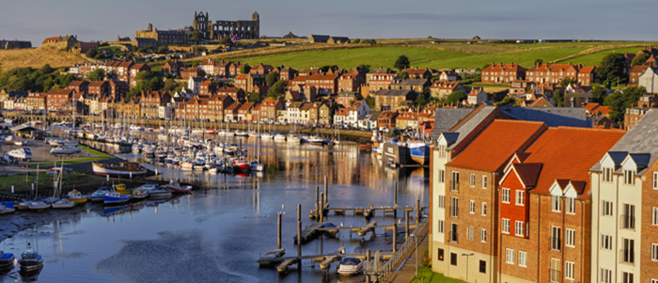
Excursion – Whitby

Slide 19
Excursion – Castle Howard

Slide 20
Excursion – Manchester Utd & Old Trafford

Slide 21
Excursion – Leeds & Leeds Gallery

Slide 22
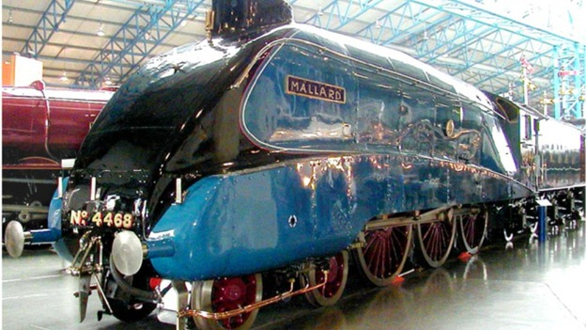
Excursion – National Railway Museum

Slide 23
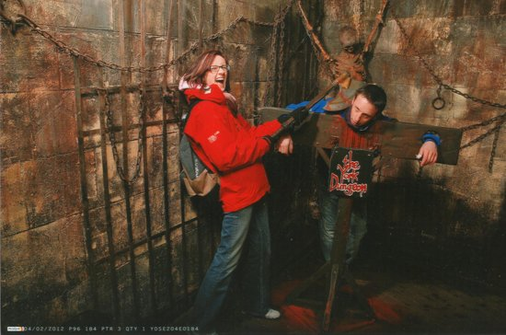
Excursion – York Dungeon

