Slide 1
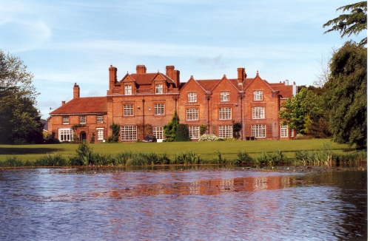
Nantwich, Reaseheath College
www.uklanguagecourses.com

Slide 2
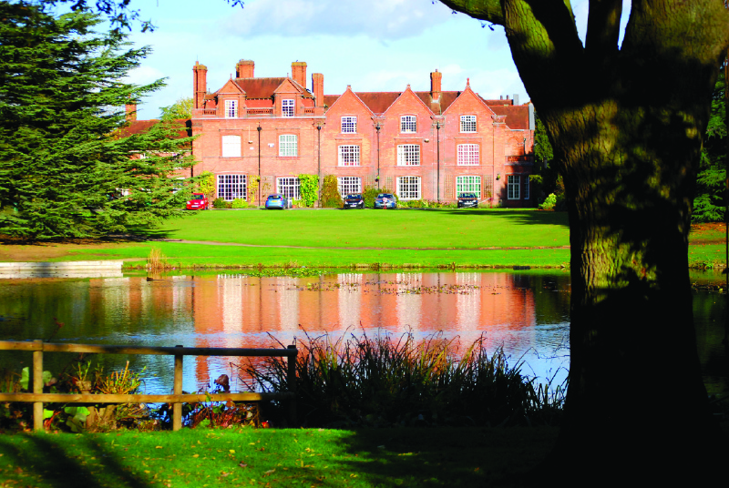
Reaseheath College, Main Building

Slide 3
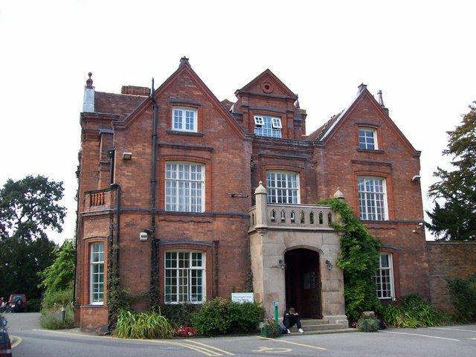
Reaseheath College External

Slide 4
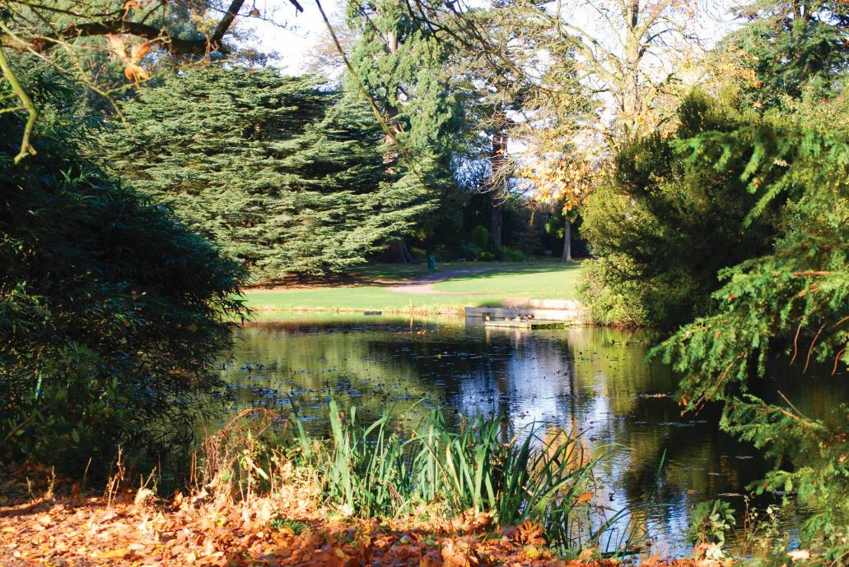
Reaseheath College Parkland Grounds

Slide 5
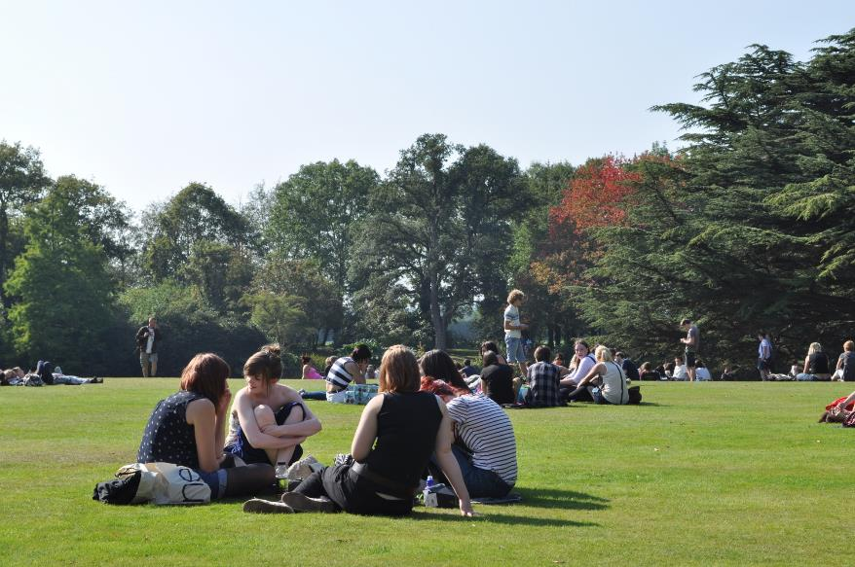
Reaseheath College, Nr. Chester

Slide 6
Reaseheath College Aerial View

Slide 7
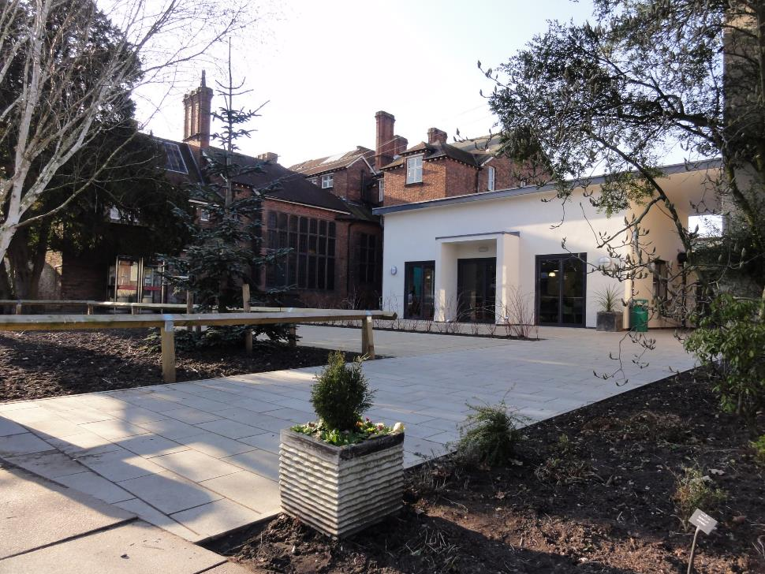
Reaseheath College External

Slide 8
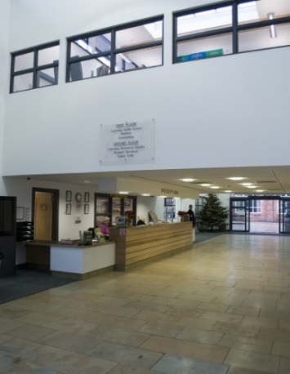
Reaseheath College Entrance

Slide 9
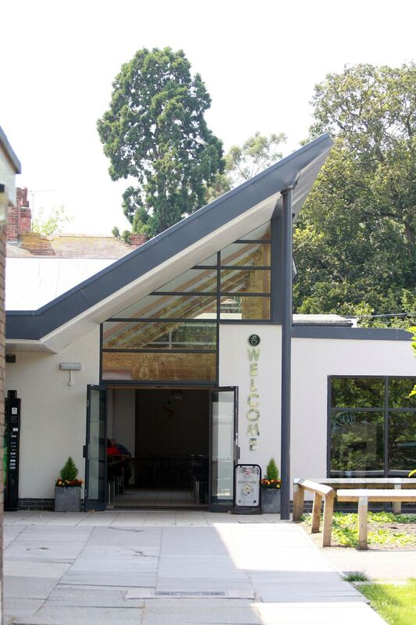
Reaseheath College
Dining Hall External

Slide 10
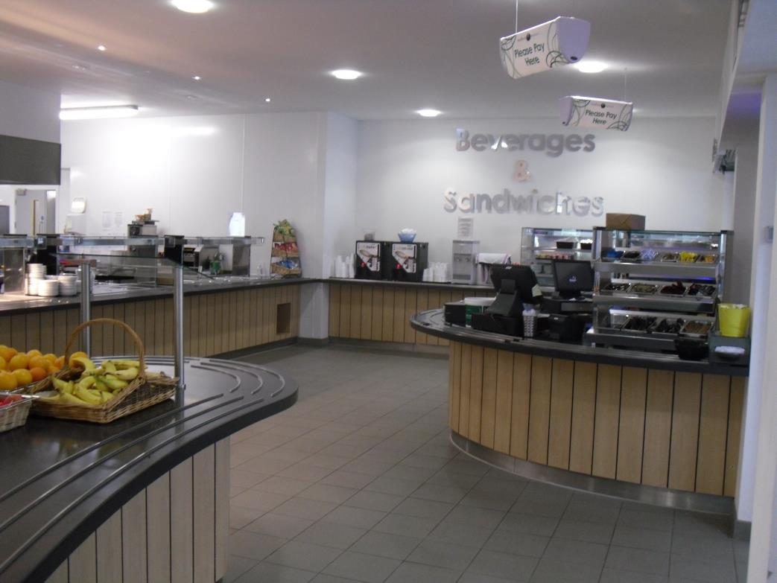
Reaseheath College Canteen

Slide 11
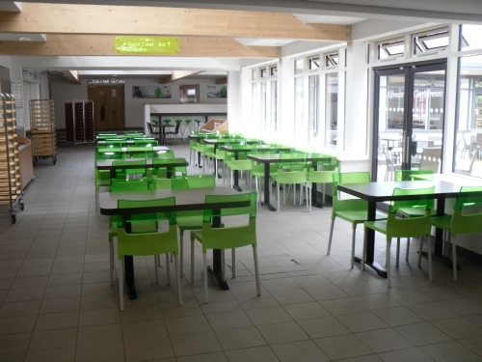
Reaseheath College Dining Room

Slide 12
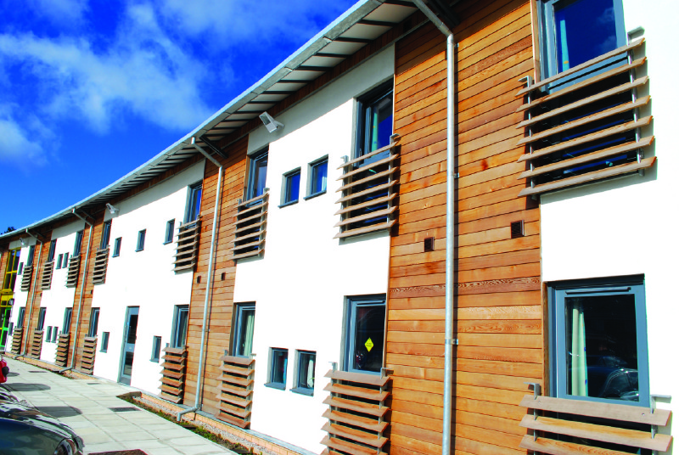
Reaseheath College Accommodation External

Slide 13
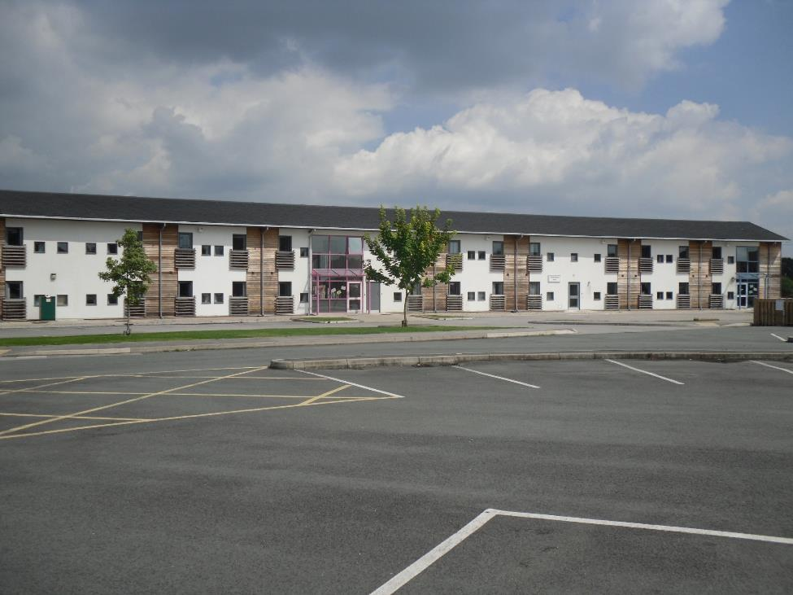
Reaseheath College Accommodation External

Slide 14
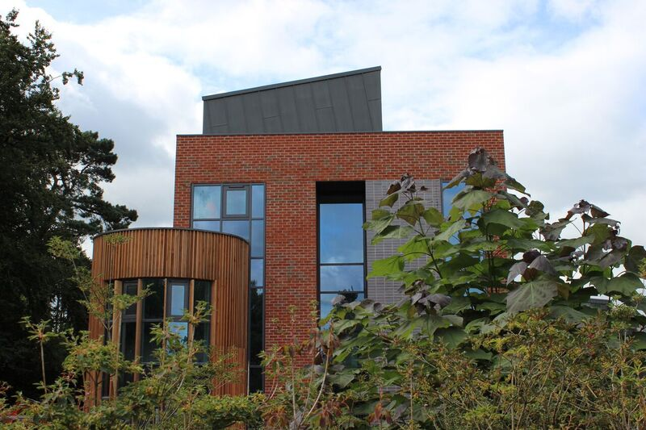
Reaseheath College, Nr. Chester

Slide 15
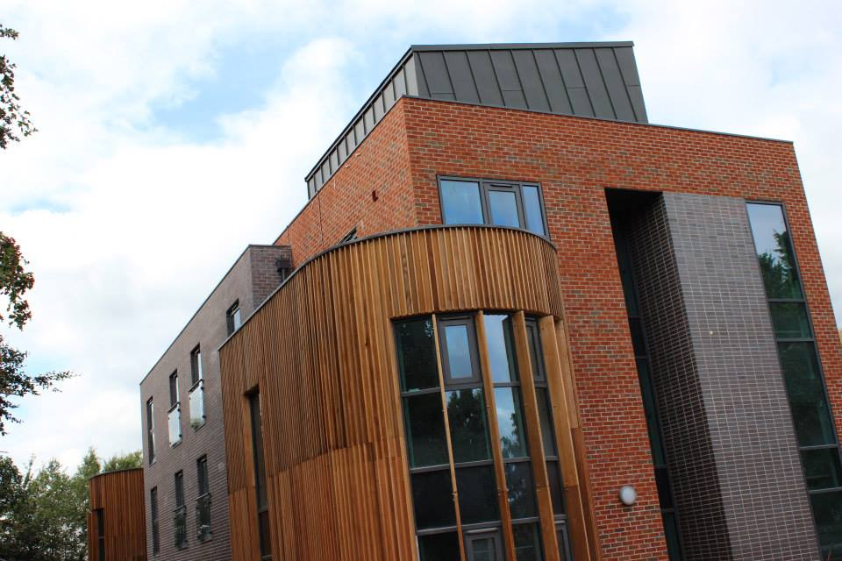
Reaseheath College Accommodation External

Slide 16
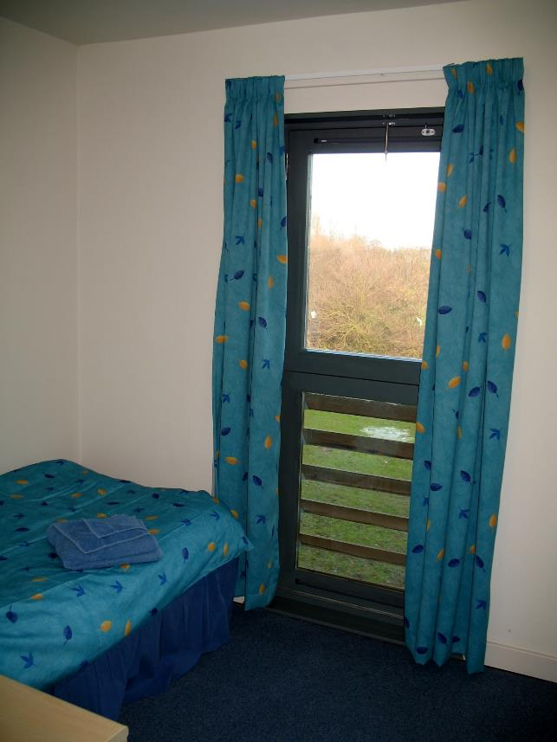
Reaseheath College
Accommodation Internal

Slide 17
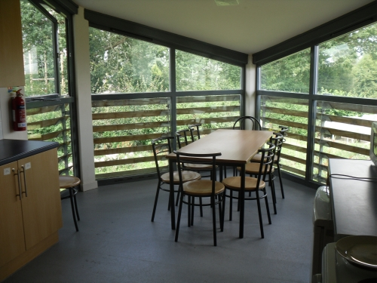
Reaseheath College Accommodation Internal

Slide 18
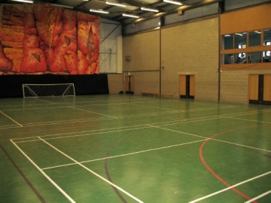
Reaseheath College Indoor Sports Hall

Slide 19
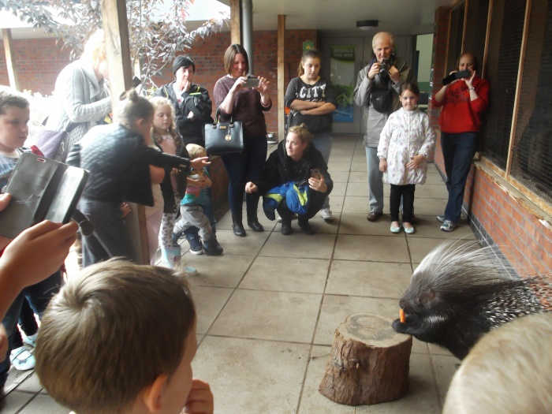
Reaseheath College, Zoo

Slide 20
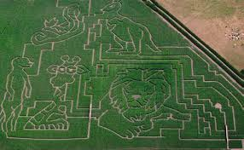
Reaseheath College Maize Maze

Slide 21
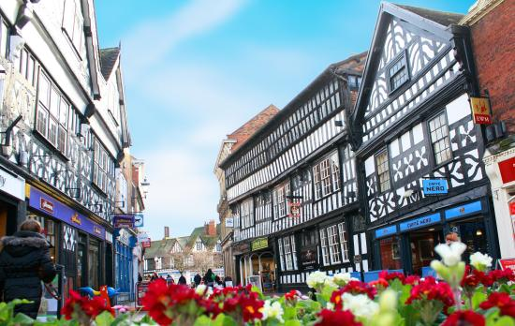
Nantwich

Slide 22
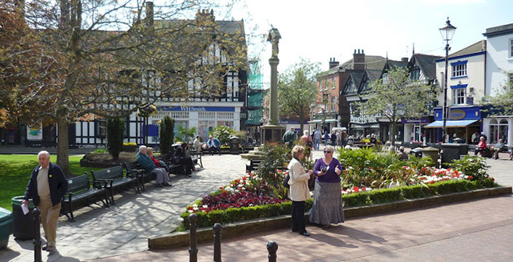
Nantwich

Slide 23
Nantwich

Slide 24
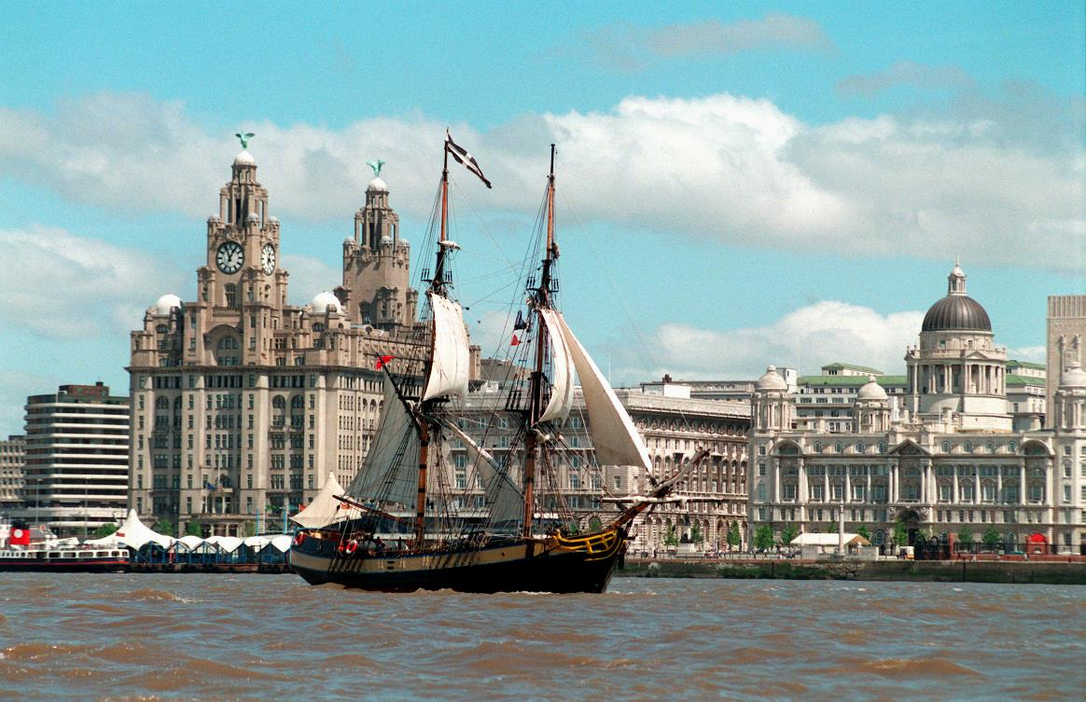
Liverpool

Slide 25
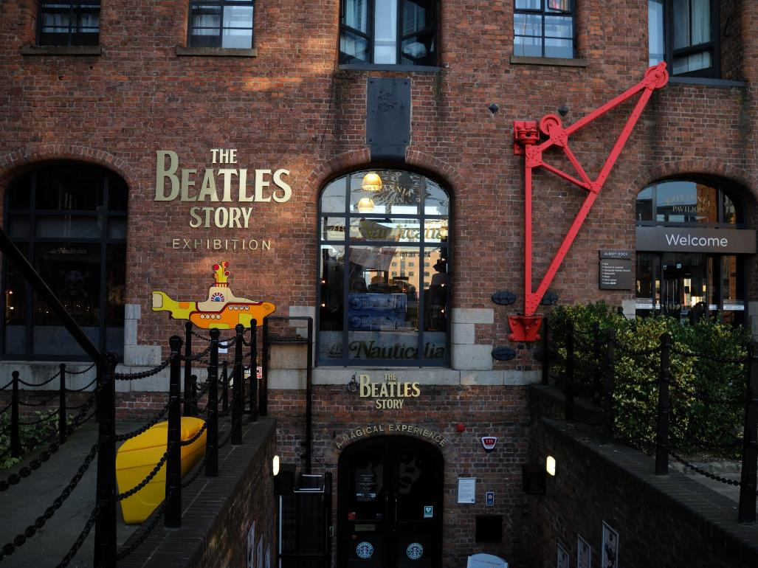
Liverpool - Beatles Story

Slide 26
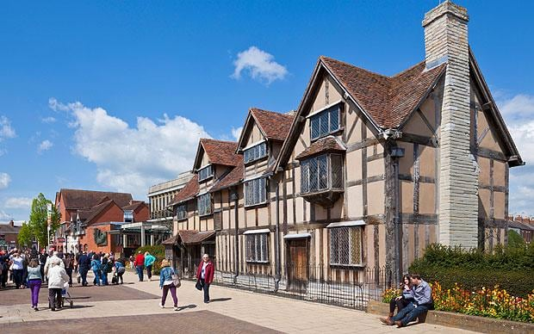
Stratford Upon Avon

Slide 27
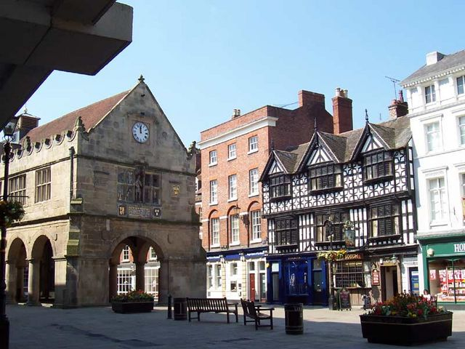
Shrewsbury

Slide 28
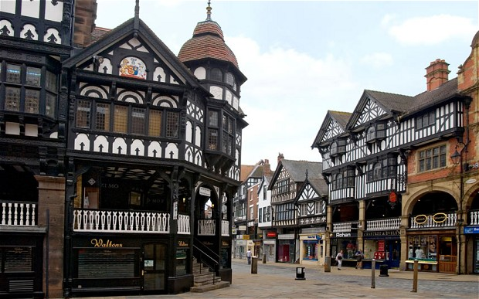
Chester

